Slide 1
Object Orientated Programming
NetBeans Integrated Development Environment (IDE)
Colm Bennett

Slide 2
1. Introduction to Algorithms
Contents
Integrated Development Environment (IDE)
Install & Configure NetBeans
Exercise

Slide 3
What is an IDE?
IDE is set of tools to aid application development.
Provides an environment where tools needed for source code editing, compiling, testing, debugging are seamlessly integrated.
Most IDEs have tools that allow you to:
Write and edit source code
See errors as you type
See highlighted code syntax
Compile code
Browse class structures
Use drag-and-drop utilities for easy building of features, such as graphic objects or creating database connections
In addition, some IDEs do:
Automatically create classes, methods, and properties
Provide code-completion as you type
Integrate with web application servers, such as WebLogic Server, JBoss, Apache Tomcat etc.

Slide 4
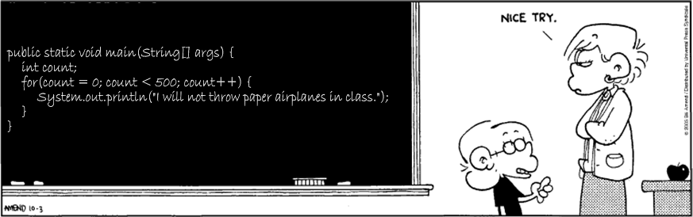
Advantages of using IDE
When developing applications it saves you time by managing windows, settings and data
Drag-and-drop features make creating GUI components or accessing databases easy
Highlighted code and debugging features alert you to errors in your code
Moving from one phase of code development to the other is very simple.
Often people start out programming using a simple text editor, but eventually they get smart!

Slide 5
IDEs for Java platform
3 Key IDE’s in use at the moment
Eclipse
Open Source
A meta IDE – supports multiple languages and server setups
Android Studio is based on this
NetBeans
Oracle’s own IDE
Also Open Source
Intelij Idea
Commercial IDE
More tightly focused on Java
Growing trend towards cloud based IDE’s, e.g. codenvy.com

Slide 6
1. NetBeans IDE
1.2 Install & Configure NetBeans
Main Features of NetBeans
Obtaining the Software
Installing the Software
Start & Configure
Getting Familiar

Slide 7
Main features
Open source => Continual improvement
Free for commercial and non-commercial use
Supported by Oracle (Sun Microsystems)
Enables developers to rapidly create:
Web, enterprise, desktop, and mobile applications using the Java platform
PHP, JavaScript and Ajax, Ruby and Ruby on Rails, Groovy, and C/C++
Provides the services common to desktop applications such as window and menu management, settings storage, etc.
Provides tools for:
Source Code Editor, GUI Builder, Database support

Slide 8
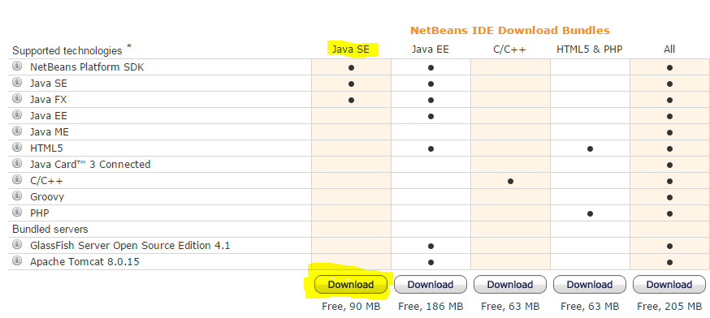
…Obtaining the Software…
Get the latest version at https://netbeans.org/downloads/index.html
Select “Java SE” Download Bundle,

Slide 9
…Obtaining the Software
3. Next download a Java Development Kit (JDK)
http://www.oracle.com/technetwork/articles/javase/index-jsp-138363.html
4. We will use Java Platform (JDK)
e.g. Java Platform (JDK) 8u31, make sure to download the Java Development Kit (JDK) and NOT the Java Runtime Edition (JRE),
E.g. http://www.oracle.com/technetwork/java/javase/downloads/jdk8-downloads-2133151.html
5. Download JDK 7u51 Application Program Interface (API) Documentation: jdk-7u51-apidocs.zip
http://download.oracle.com/otn-pub/java/jdk/7u51-b13/jdk-7u51-apidocs.zip

Slide 10
Installing the Software
Install the downloaded JDK .exe file
Take a note of where you are installing the JDK
Install the downloaded NetBeans file
Select the correct JDK when prompted, see above
Start the application => You will notice the welcome screen,
In Windows: Start-> Programs -> NetBeans -> NetBeans IDE X.x.x

Slide 11
Getting Familiar
In NetBeans, we work within the context of a project
A project consists of:
An organised group of source files and associated metadata
Project-specific properties files
All the tools you'll need to write, compile, test, and debug your application

Slide 12
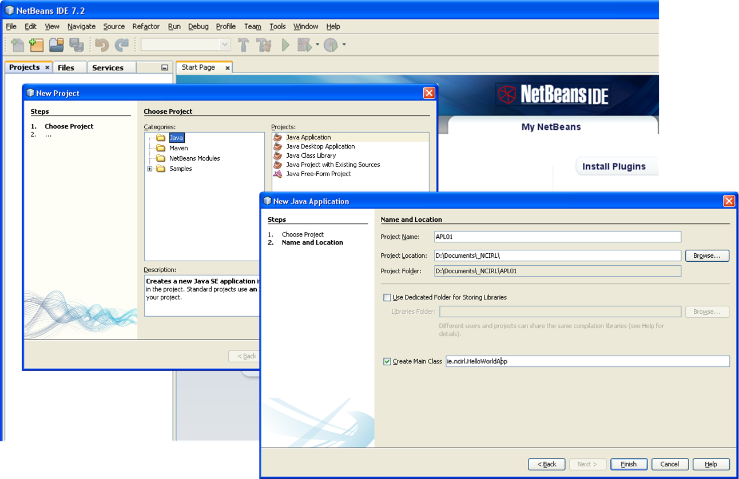
1. NetBeans IDE
Exercise 1.1 – A New Application
Step 1: Create a project (APL01)

Slide 13
1. NetBeans IDE
Exercise 1.1 – A New Application
The skeleton of your java application was created
Projects tab
Source Packages: All packages and java files for this project
Main steps:
Start to edit your source code
We already have Main class, but we need to write code in the main() method and other methods that we want to develop.
Add the following code in the main()
System.out.println("Hello World");

Slide 14
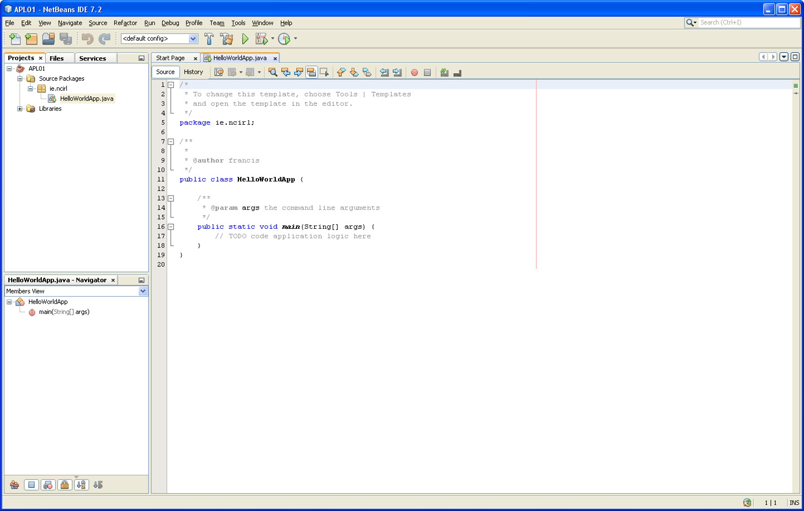
1. NetBeans IDE
Exercise 1.1 – A New Application

Slide 15
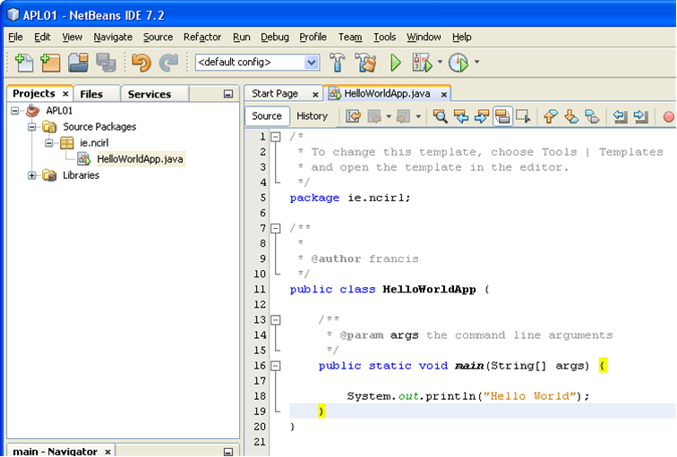
1. NetBeans IDE
Exercise 1.1 – A New Application
Add the following line of Java code,
System.out.println("Hello World");
the main method as shown below,
public static void main(String[] args) {
System.out.println("Hello World");
}

Slide 16
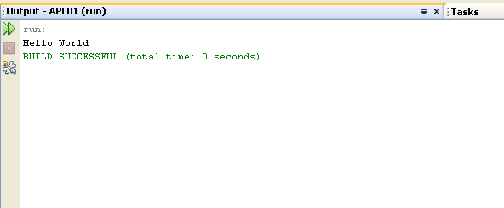
1. NetBeans IDE
Exercise 1.1 – A New Application
Compiling the Java File(s)
The IDE automatically compiles the program when you save the file so there is no need to separately compile.
Running the program
Click the green run arrow
Or, from the main menu, Run =>Run Main Project (F6),
The output of the program is displayed in the Output Windows.

Slide 17
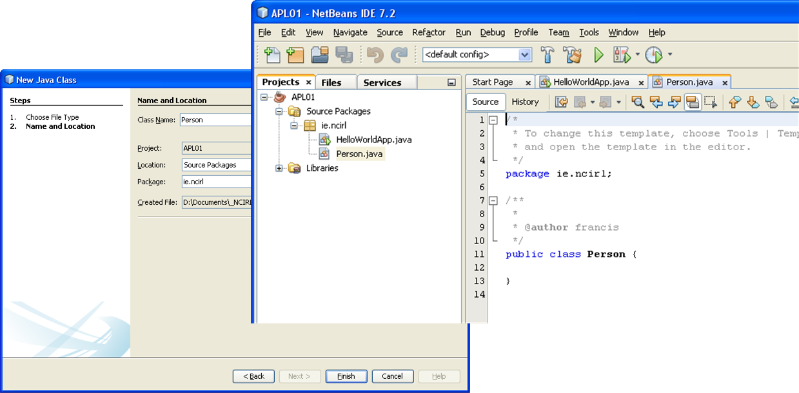
1. NetBeans IDE
Exercise 1.1 – A New Application
Add/Write new Java classes to your project
Create Person class
File=>New File=> Java Class as class types => press Next button
Set Class Name: Person, then press Finish button
Edit the Person class: Projects window and then click on Person.java

Slide 18
1. NetBeans IDE
Exercise 1.1 – A New Application
Person class - design
Attributes:
public String name;
public int age;
Constructor:
Person (String inName, int inAge)
Methods:
public String getName()
public void setName(String inName)
public int getAge()
public void setAge(int inAge)
public void printPerson()

Slide 19
1. NetBeans IDE
Learning Outcome
What is IDE?
List examples of IDEs for Java platform?
What are the characteristics of the NetBeans IDE?
How to create, develop, compile, debug and run a simple java application developed in NetBeans?
How to develop GUI for a NetBeans project?

Slide 20

Questions

